Slide 1
Part-Based Room Categorization for Household Service Robots
Peter Uršič¹, Rok Mandeljc¹, Aleš Leonardis², Matej Kristan¹
¹ Faculty of Computer and Information Science, University of Ljubljana, Slovenia
² School of Computer Science, University of Birmingham, United Kingdom

Slide 2
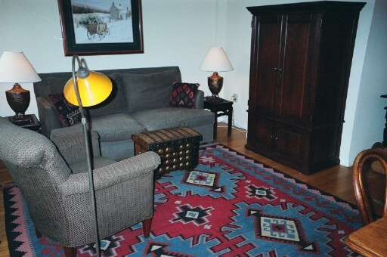
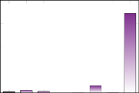
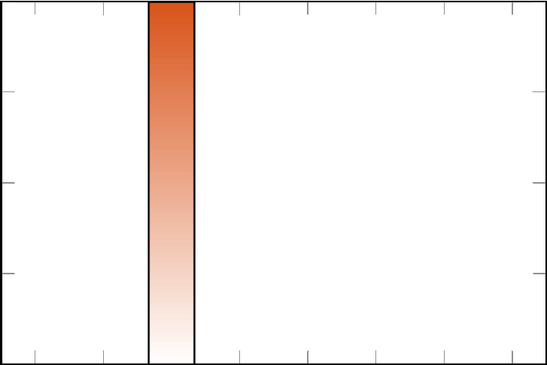
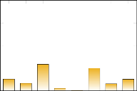
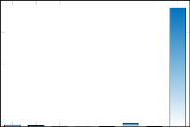

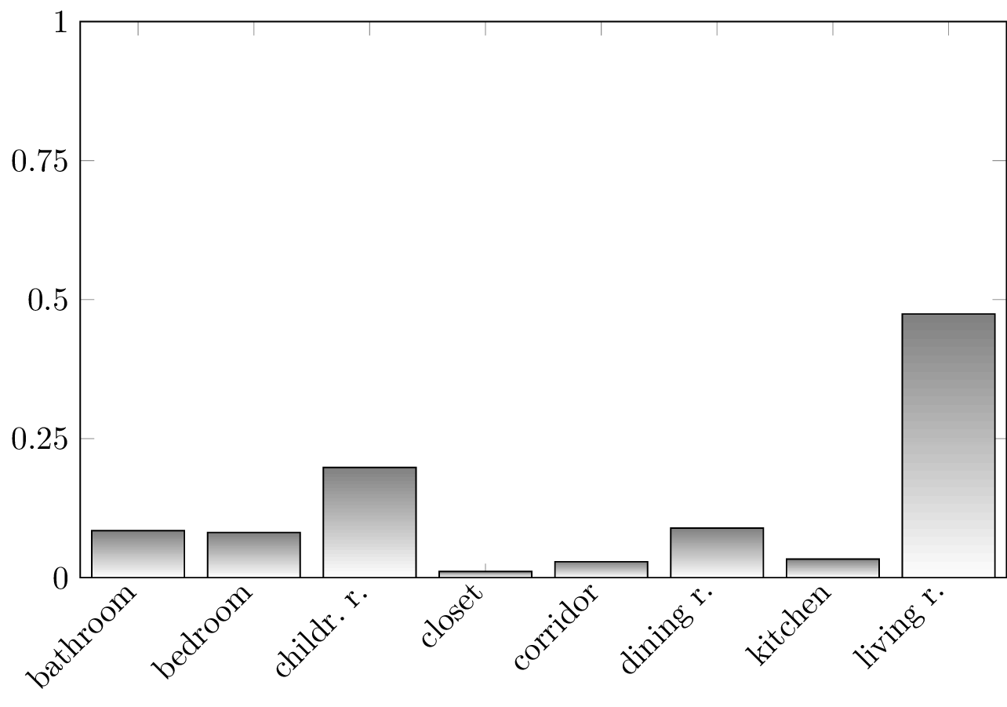
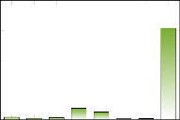
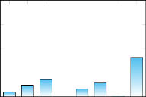
Part-Based Room Categorization for Household Service Robots
visual room categorization / semantic localization
monocular image → room category prediction
object-agnostic region proposal
part category
predictions
mixture
model
?
final prediction
Living room!
CNN features
pre-trained
CNN
exemplar-based
classification

Slide 3
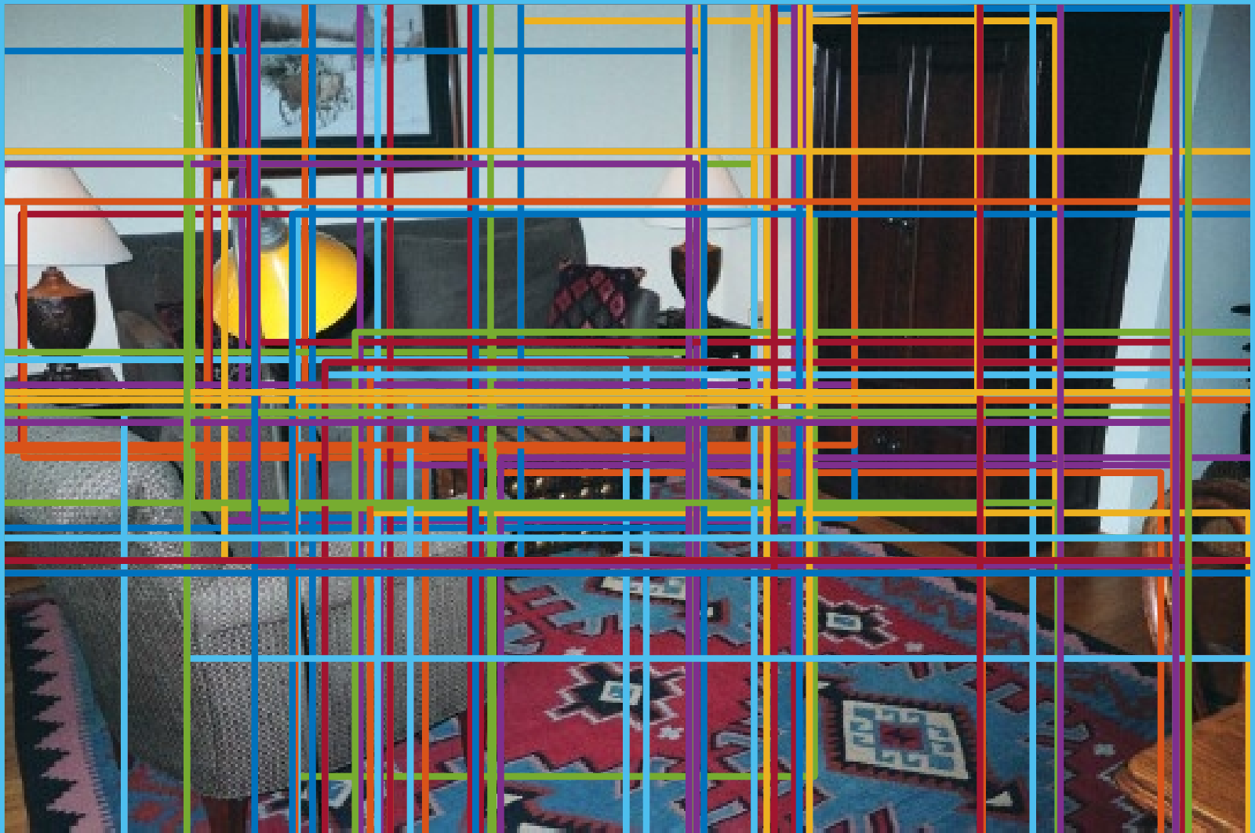
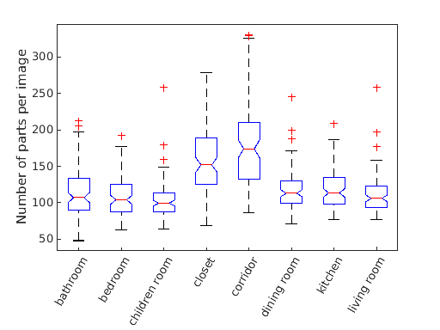
Object-agnostic region proposals
Selective Search^{[1]} (or equivalent)
large number of regions/parts
[1] J. Uijlings, K. van de Sande, T. Gevers, and A. Smeulders, “Selective search for object recognition,” Int. J. Comput. Vision, 2013.

Slide 4
Convolutional Neural Network feature extractor
hybrid-CNN^{[1]}
  Caffe reference network
  trained on 1183 categories, ~3.6 million images
    205 scene categories (Places dataset)
    978 object categories (ILSVRC2012 / ImageNet)
features: response of FC7 layer
  4096-dimensional feature vectors
[1] B. Zhou, A. Lapedriza, J. Xiao, A. Torralba, and A. Oliva, “Learning deep features for scene recognition using places database,” NIPS 2014

Slide 5
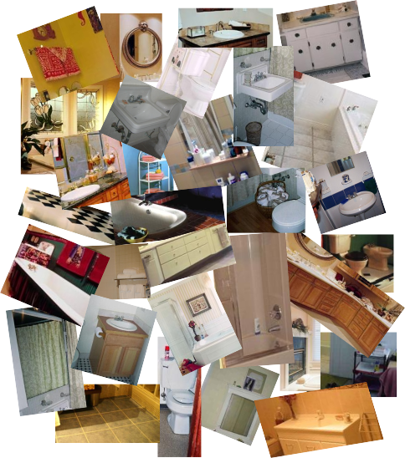
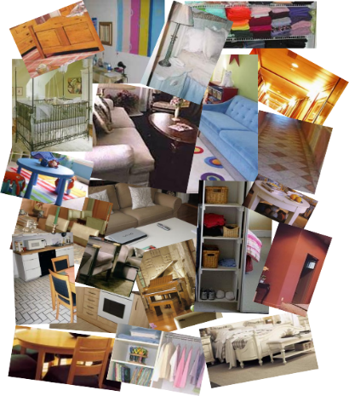
Exemplar-based classification
discriminative dictionary of exemplars for each category:
positive exemplars for „bathroom“
negative exemplars for „bathroom“

Slide 6
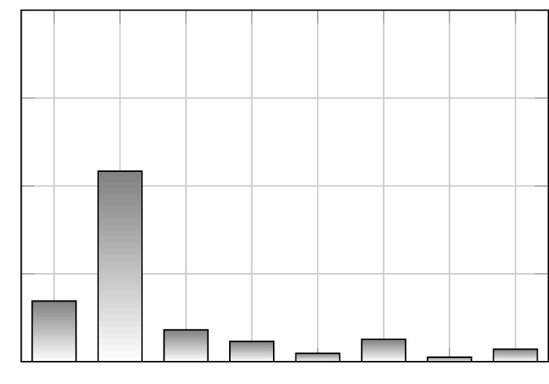
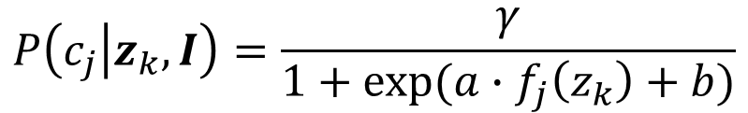
Exemplar-based classification
optimization of multiclass linear SVM (support vectors → exemplars)
classify each part of image I, encoded by feature vector z_{k}
Platt‘s probabilistic calibration
alternative classification methods: e.g., MCABE (Uršič et al., ICRA2016 - ThBaT1.6)
posterior for part z_{k} over all categories
normalization factor
$$P\left(c_{j} | z_{k},I\right)=\frac{γ}{1+exp⁡(a∙f_{j}\left(z_{k}\right)+b)}$$
probability of j-th category
score of j-th classifier
Notes:
TODO!

Slide 7
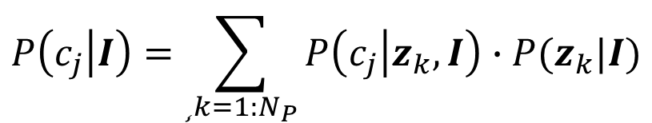
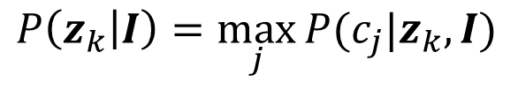
Mixture model
combine posteriors of individual parts into final posterior for the whole image:
prior should reflect the informativeness of the part; parts with peaked likelihood across the alternative categories should contribute more:
$$P\left(c_{j} | I\right)=\sum_{¸k=1:N_{P}}{P\left(c_{j} | z_{k},I\right)∙P(z_{k}|I)}$$
probability of j-th category for k-th part
prior for k-th part
$$P\left(z_{k} | I\right)=\max_{j}{P(c_{j}|z_{k},I)}$$

Slide 8
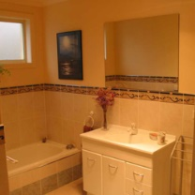
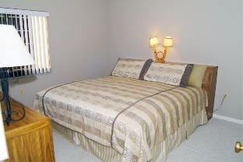
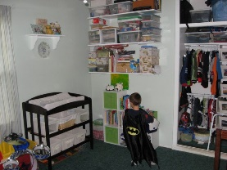
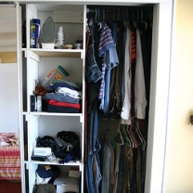
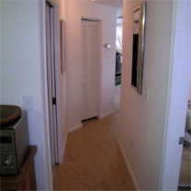
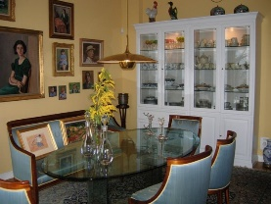
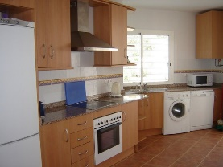

Dataset
8-category subset of the MIT Indoor67 dataset^{[1]}
  bathroom
  bedroom
  children‘s room
  closet
  corridor
  dining room
  kitchen
  living room
official training/testing split
  80 training, 20 test images per category
[1] A. Quattoni and A. Torralba, “Recognizing indoor scenes,” CVPR 2009

Slide 9
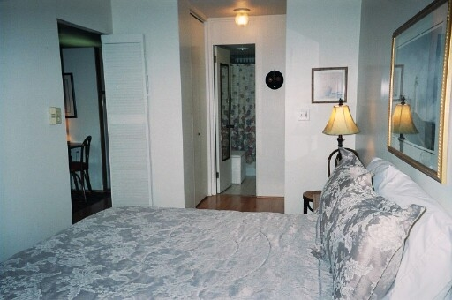
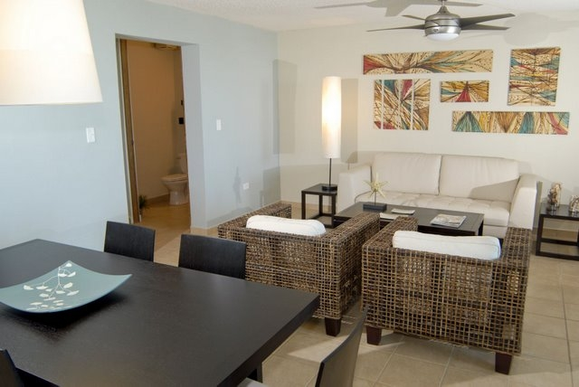
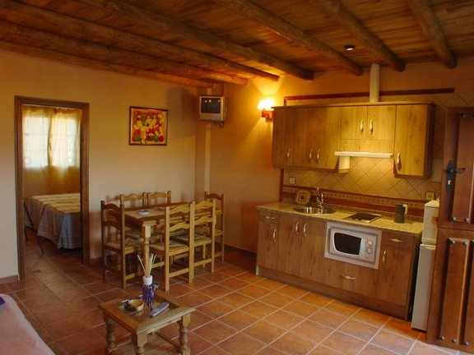
Dataset
Incorrect annotations in the original dataset
  4% of samples
  incorrect labels, duplicates across training and test set
bathroom/indoor_0323.jpg
duplicate of
bedroom/indoor_0323.jpg
from training set
bathroom/dsc3101.jpg
duplicate of
livingroom/dsc3101.jpg
from test set
bedroom/dsc04183.jpg
duplicate of
kitchen/dsc04183.jpg
from training set

Slide 10
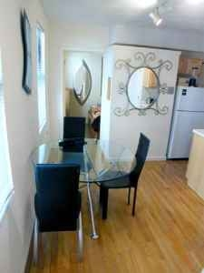
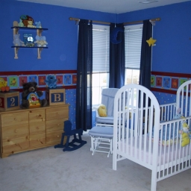
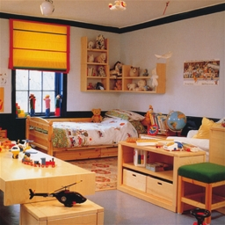
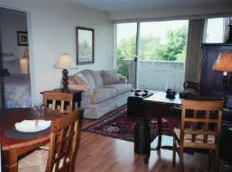

Dataset
Revised 8-category subset available at:
  http://vision.fe.uni-lj.si/~rokm/icra2016/household_room_dataset
bedroom/indoor_0057.jpg
bedroom/hunter_room.jpg
bedroom/indoor_0113.jpg
bedroom/strongcpl_t.jpg

Slide 11
Experimental results
Classification accuracy:
better on children‘s rooms, worse on bedrooms
holistic hybrid-CNN^{[1]}
our part-based approach
 | bath. | bedr. | ch.r. | clo. | cor. | din. r. | kitch. | liv. r.
bathroom | 16 | 0 | 0 | 0 | 0 | 0 | 1 | 0 | target class label
bedroom | 0 | 17 | 1 | 1 | 0 | 0 | 0 | 2
child. r. | 0 | 1 | 14 | 1 | 0 | 0 | 1 | 1
closet | 0 | 0 | 0 | 17 | 1 | 0 | 0 | 0
corridor | 0 | 0 | 0 | 0 | 21 | 0 | 0 | 0
dining r. | 1 | 0 | 0 | 0 | 0 | 11 | 0 | 1
kitchen | 1 | 0 | 0 | 0 | 0 | 0 | 20 | 0
living r. | 1 | 1 | 0 | 0 | 0 | 5 | 1 | 18
 | predicted class label (accuracy: 86.45 %)
 | bath. | bedr. | ch.r. | clo. | cor. | din. r. | kitch. | liv. r.
bathroom | 17 | 0 | 0 | 0 | 0 | 0 | 0 | 0 | target class label
bedroom | 0 | 13 | 2 | 1 | 0 | 0 | 0 | 5
child. r. | 0 | 1 | 17 | 0 | 0 | 0 | 0 | 0
closet | 0 | 0 | 0 | 17 | 1 | 0 | 0 | 0
corridor | 0 | 0 | 0 | 0 | 19 | 1 | 1 | 0
dining r. | 2 | 0 | 0 | 0 | 0 | 10 | 1 | 0
kitchen | 0 | 0 | 0 | 0 | 0 | 0 | 21 | 0
living r. | 1 | 1 | 1 | 0 | 0 | 4 | 1 | 18
 | predicted class label (accuracy: 86.45 %)
[1] B. Zhou et al., “Learning deep features for scene recognition using places database,” NIPS 2014

Slide 12
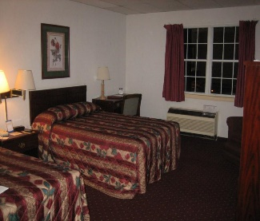
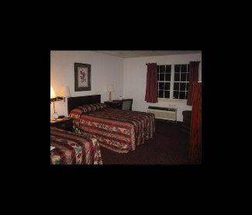
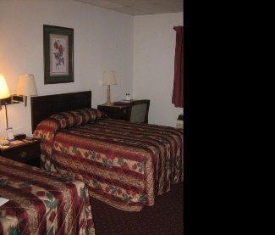
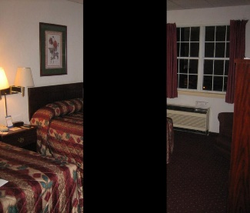
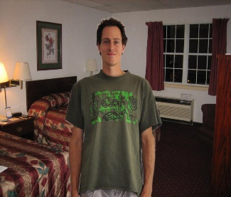
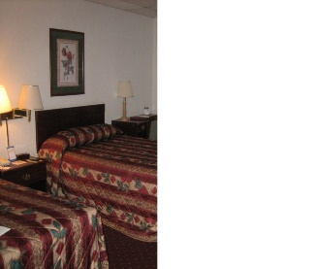
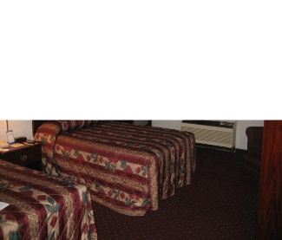
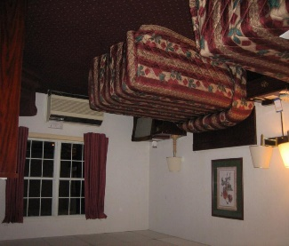
Experimental results
Robustness study: effect of various image distortions
experiment | holistic hybrid-CNN | our part-based approach
original image | 86.45 % | 85.16 %
outside border | 62.58 % | 85.16 %
black occluder, right | 78.71 % | 80.00 %
black occluder, central | 61.94 % | 69.68 %
person occluder, central | 59.35 % | 68.39 %
cut right half | 62.58 % | 64.52 %
cut top half | 52.26 % | 68.39 %
upside down | 52.26 % | 59.35 %
average | 64.52 % | 72.58 %
original image
outside border
black occluder, r.
black occluder, c.
person occluder, c.
cut right half
cut top half
upside down

Slide 13
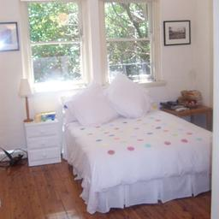
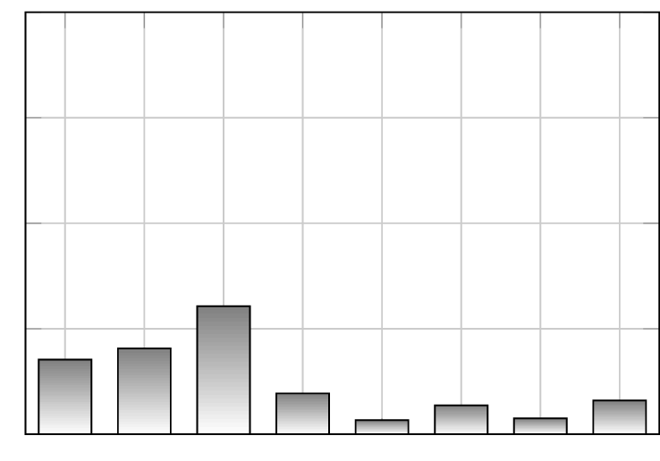
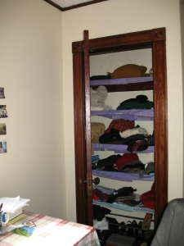
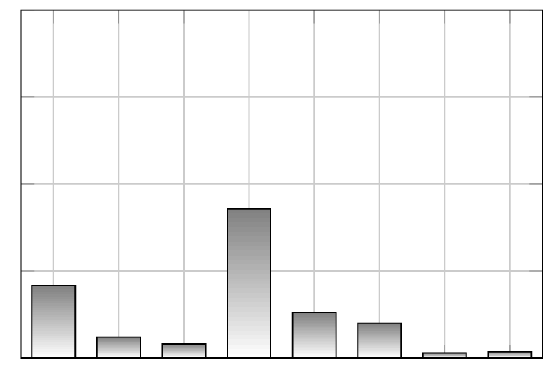
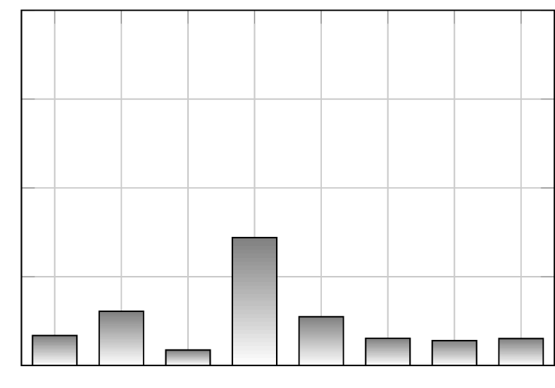
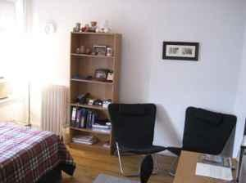
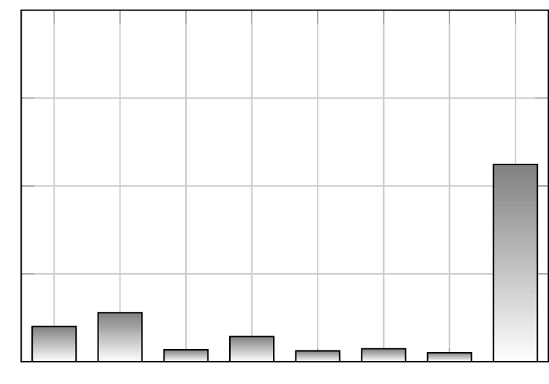
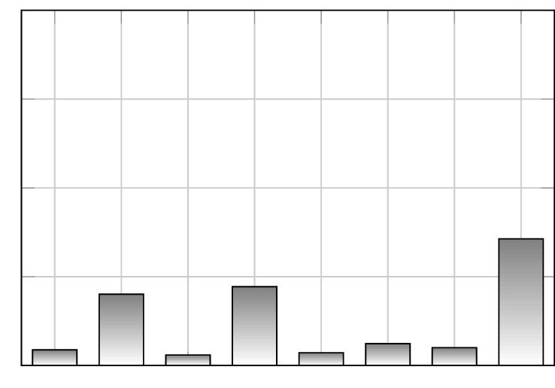
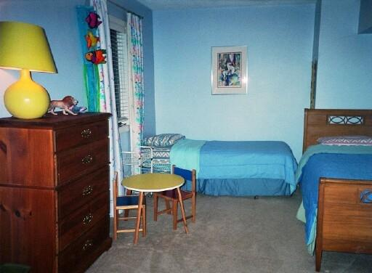
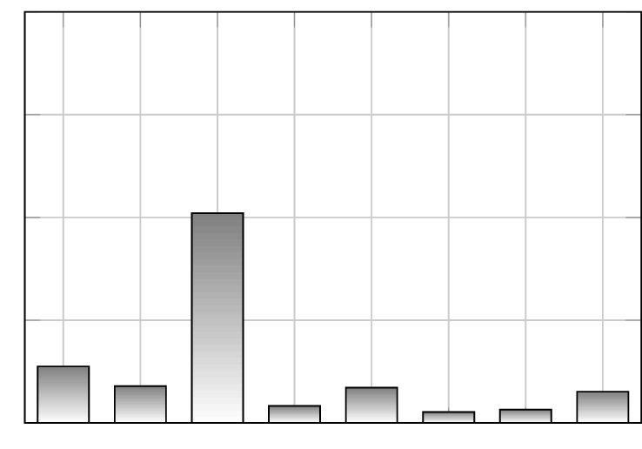
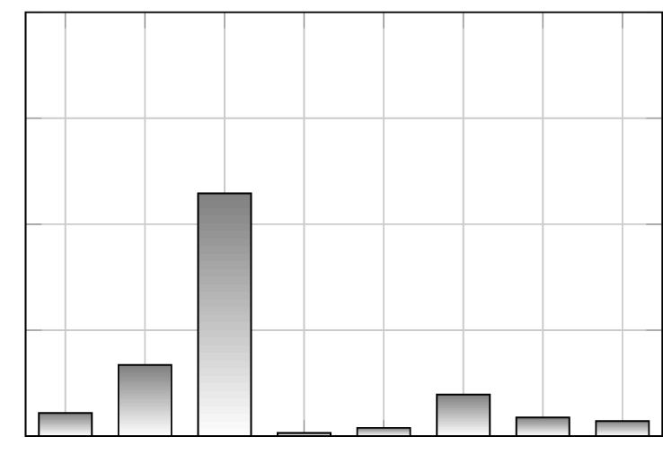
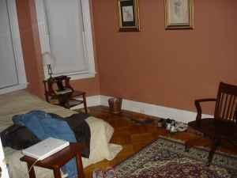





Detailed analysis: difficult samples
label: bedroom
holistic: bedroom
part-based: child. r.
label: bedroom
holistic: closet
part-based: closet
label: bedroom
holistic: living r.
part-based: living r.
label: bedroom
holistic: child. r.
part-based: child. r.
label: bedroom
holistic: living r.
part-based: living r.
label: child. r.
holistic: bedroom
part-based: bedroom

Slide 14








Detailed analysis: failure mode
input image (103 regions)
final prediction: kitchen
individual region categorizations

Slide 15








Detailed analysis: advantages of using parts
final prediction: living room
input image (70 regions)
individual region categorizations

Slide 16
Towards semantic segmentation
pixel-wise semantic segmentation
focus of attention, visual servoing
apply the same mixture model as before, at pixel level
Notes:
TODO!

Slide 17




Towards semantic segmentation
closet
bedroom
living room
children‘s room
dining room

