Slide 1
Part-Based Room Categorization for Household Service Robots
Peter Uršič¹, Rok Mandeljc¹, Aleš Leonardis², Matej Kristan¹
¹ Faculty of Computer and Information Science, University of Ljubljana, Slovenia
² School of Computer Science, University of Birmingham, United Kingdom

Slide 2
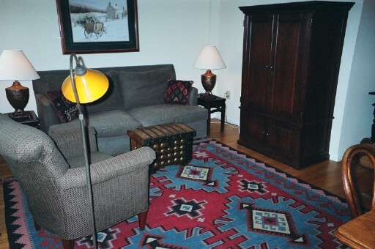

The problem
Visual room categorization
Semantic localization
Input: monocular image
Output: room prediction
kitchen
closet
?
corridor
dining room
living room
bedroom
bathroom
children‘s room

Slide 3
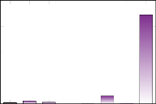
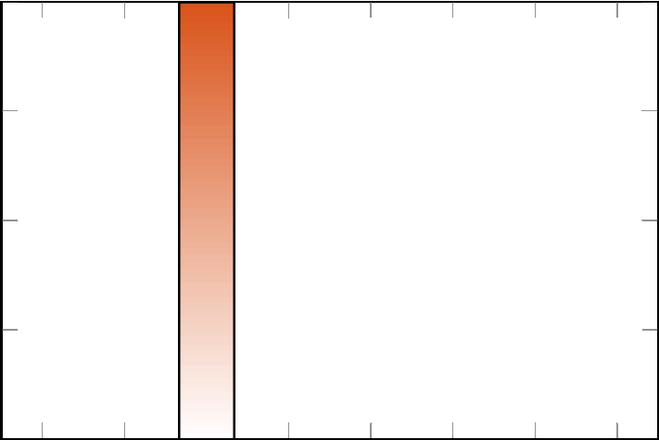
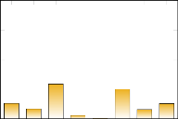

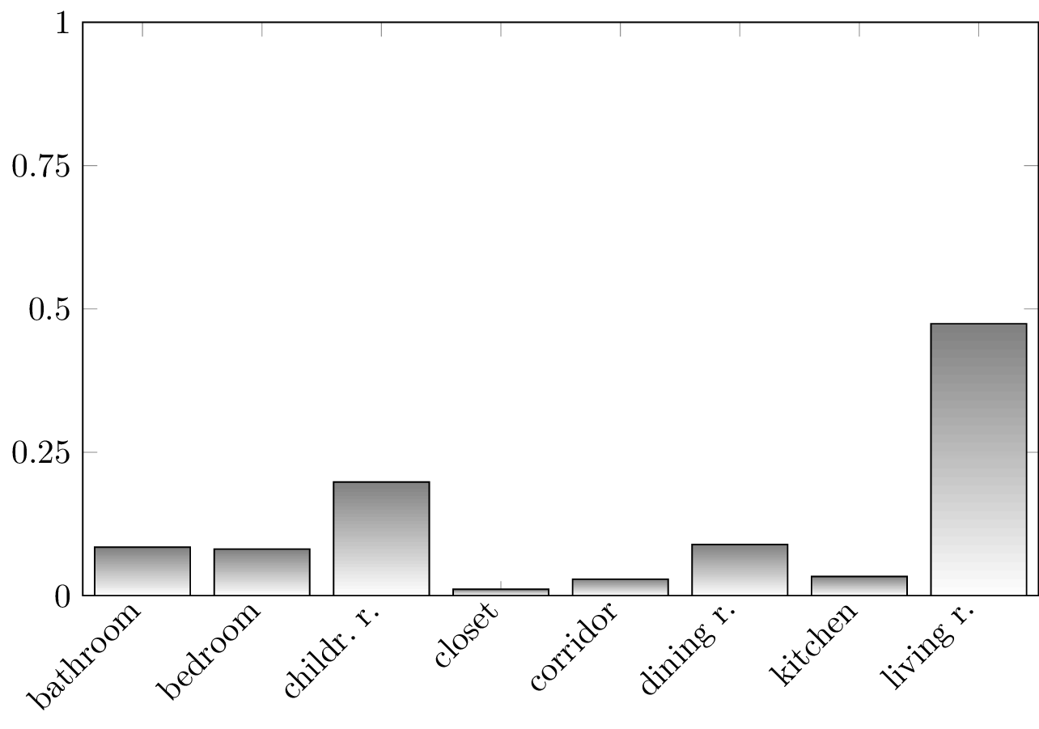
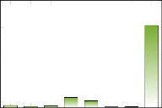
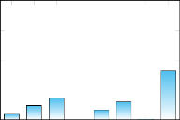
Our approach
Object-agnostic region proposals → parts
Pre-trained Convolutional Neural Network features
Mixture model
region proposals
part category
predictions
mixture
model
final prediction
Living room!
CNN features
pre-trained
CNN
exemplar-based
classification

Slide 4
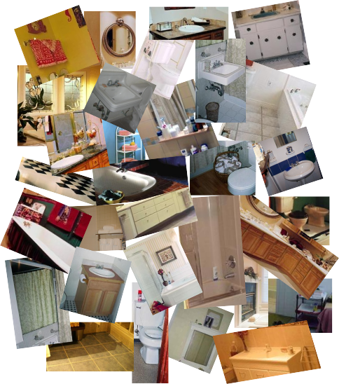
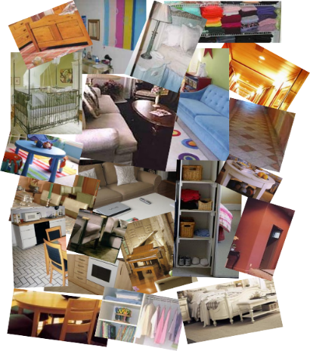
Our approach
Discriminative dictionary of category exemplars
Support Vector Machine optimization
positive exemplars for „bathroom“
negative exemplars for „bathroom“

Slide 5
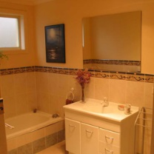
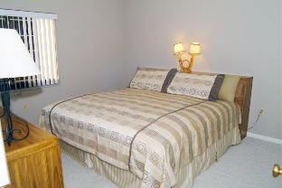
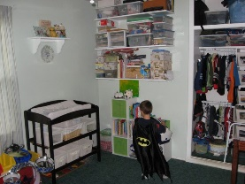
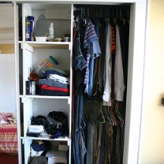
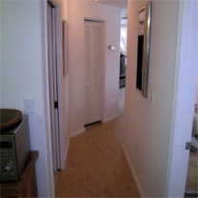
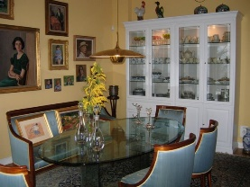
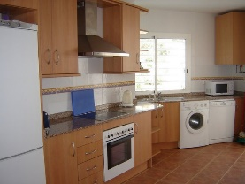

From semantic localization…
8-category subset of MIT Indoor67 dataset^{[1]}: bathroom, bedroom, children‘s room, closet, corridor, dining room, kitchen, living room
Improved performance over state-of-the-art holistic approach^{[2]}:
Occlusions
Partial view
Scale changes
Aspect-ratio changes
[1] A. Quattoni and A. Torralba, “Recognizing indoor scenes,” CVPR 2009
[2] B. Zhou et al., “Learning deep features for scene recognition using places database,” NIPS 2014

Slide 6
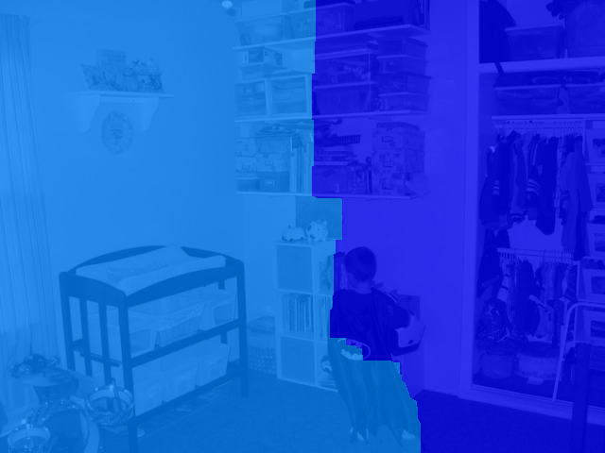
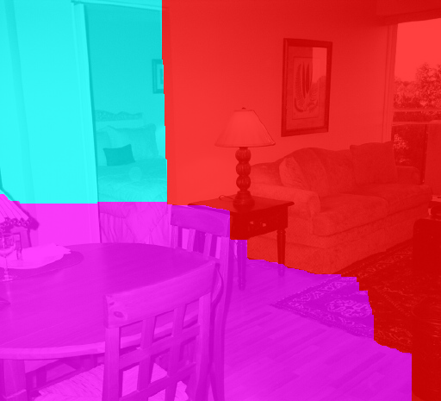
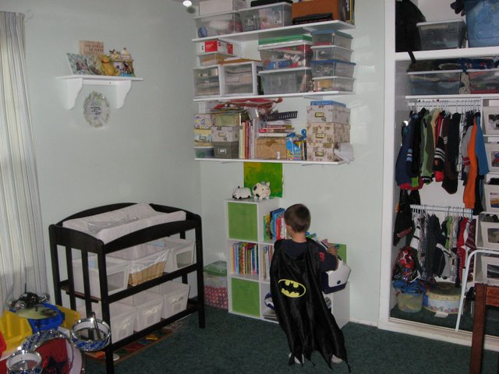
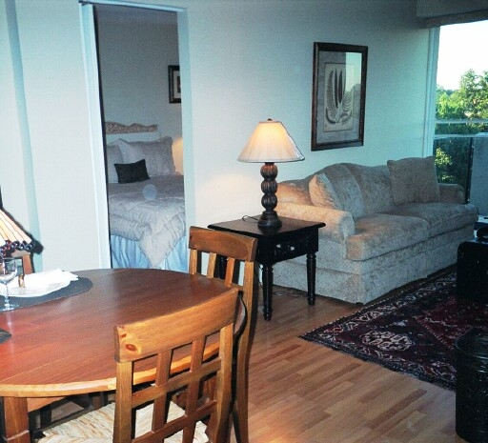
… towards semantic segmentation
Pixel-wise semantic segmentation of scene
closet
bedroom
living room
children‘s room
dining room

